Slide 1
CSS342 Data Structures, Algorithms, and Discrete Mathematics (I)

Slide 2
Goal by the end of this week (10/8, 10/10)
Join Disco (I will not double-post announcement to Canvans)
Get more comfortable with write C++, Makefile
Get familiar with Cmake
OOP design
Better Code/Testing Quality
Textbook

Slide 3
C++
We will only review C++ quickly
If in high doubt
CSS332 Programming with object oriented languages
A longer “boot camp” on C++
Although this is not a prerequisite for CSS342, do take this class if at all possible if you are not familiar with C++
Quantitative Skills Center (tutoring) – Visit http://www.uwb.edu/gsc for more information
A good video tutorial series

Slide 4
Homework Rules
Work alone unless specified otherwise
No Plagiarism
“the practice of taking someone else's work or ideas and passing them off as one's own”
Use internet resources for idea is OK if proper credit is given
“I got this algorithm idea from xxx”
Serious consequence!!!
Late homework will NOT be accepted
exception will be given on a very very rare and case by case basis with legit proof of circumstances
Ask questions on disco/slack channels and/or at office hours

Slide 5
Homework Review
link to home 2
do bonus first
DUE: 10/14/2019 Monday 11:59pm
We will review homework 1 on Thursday
A few problems I’ve seen in submission:
Read the problem description carefully. Ask if not clear.
Reuse code.
SWAP function in reverse() and sort()
Test more thoroughly
testAdd()
testReverse()
Only submit files asked. No executables!
Test should say PASS or FAIL

Slide 6
Linux
A great intro tutorial video

Slide 7
C++ Review
Polymorphism, Virtual function (virtual_function_example)

Slide 8
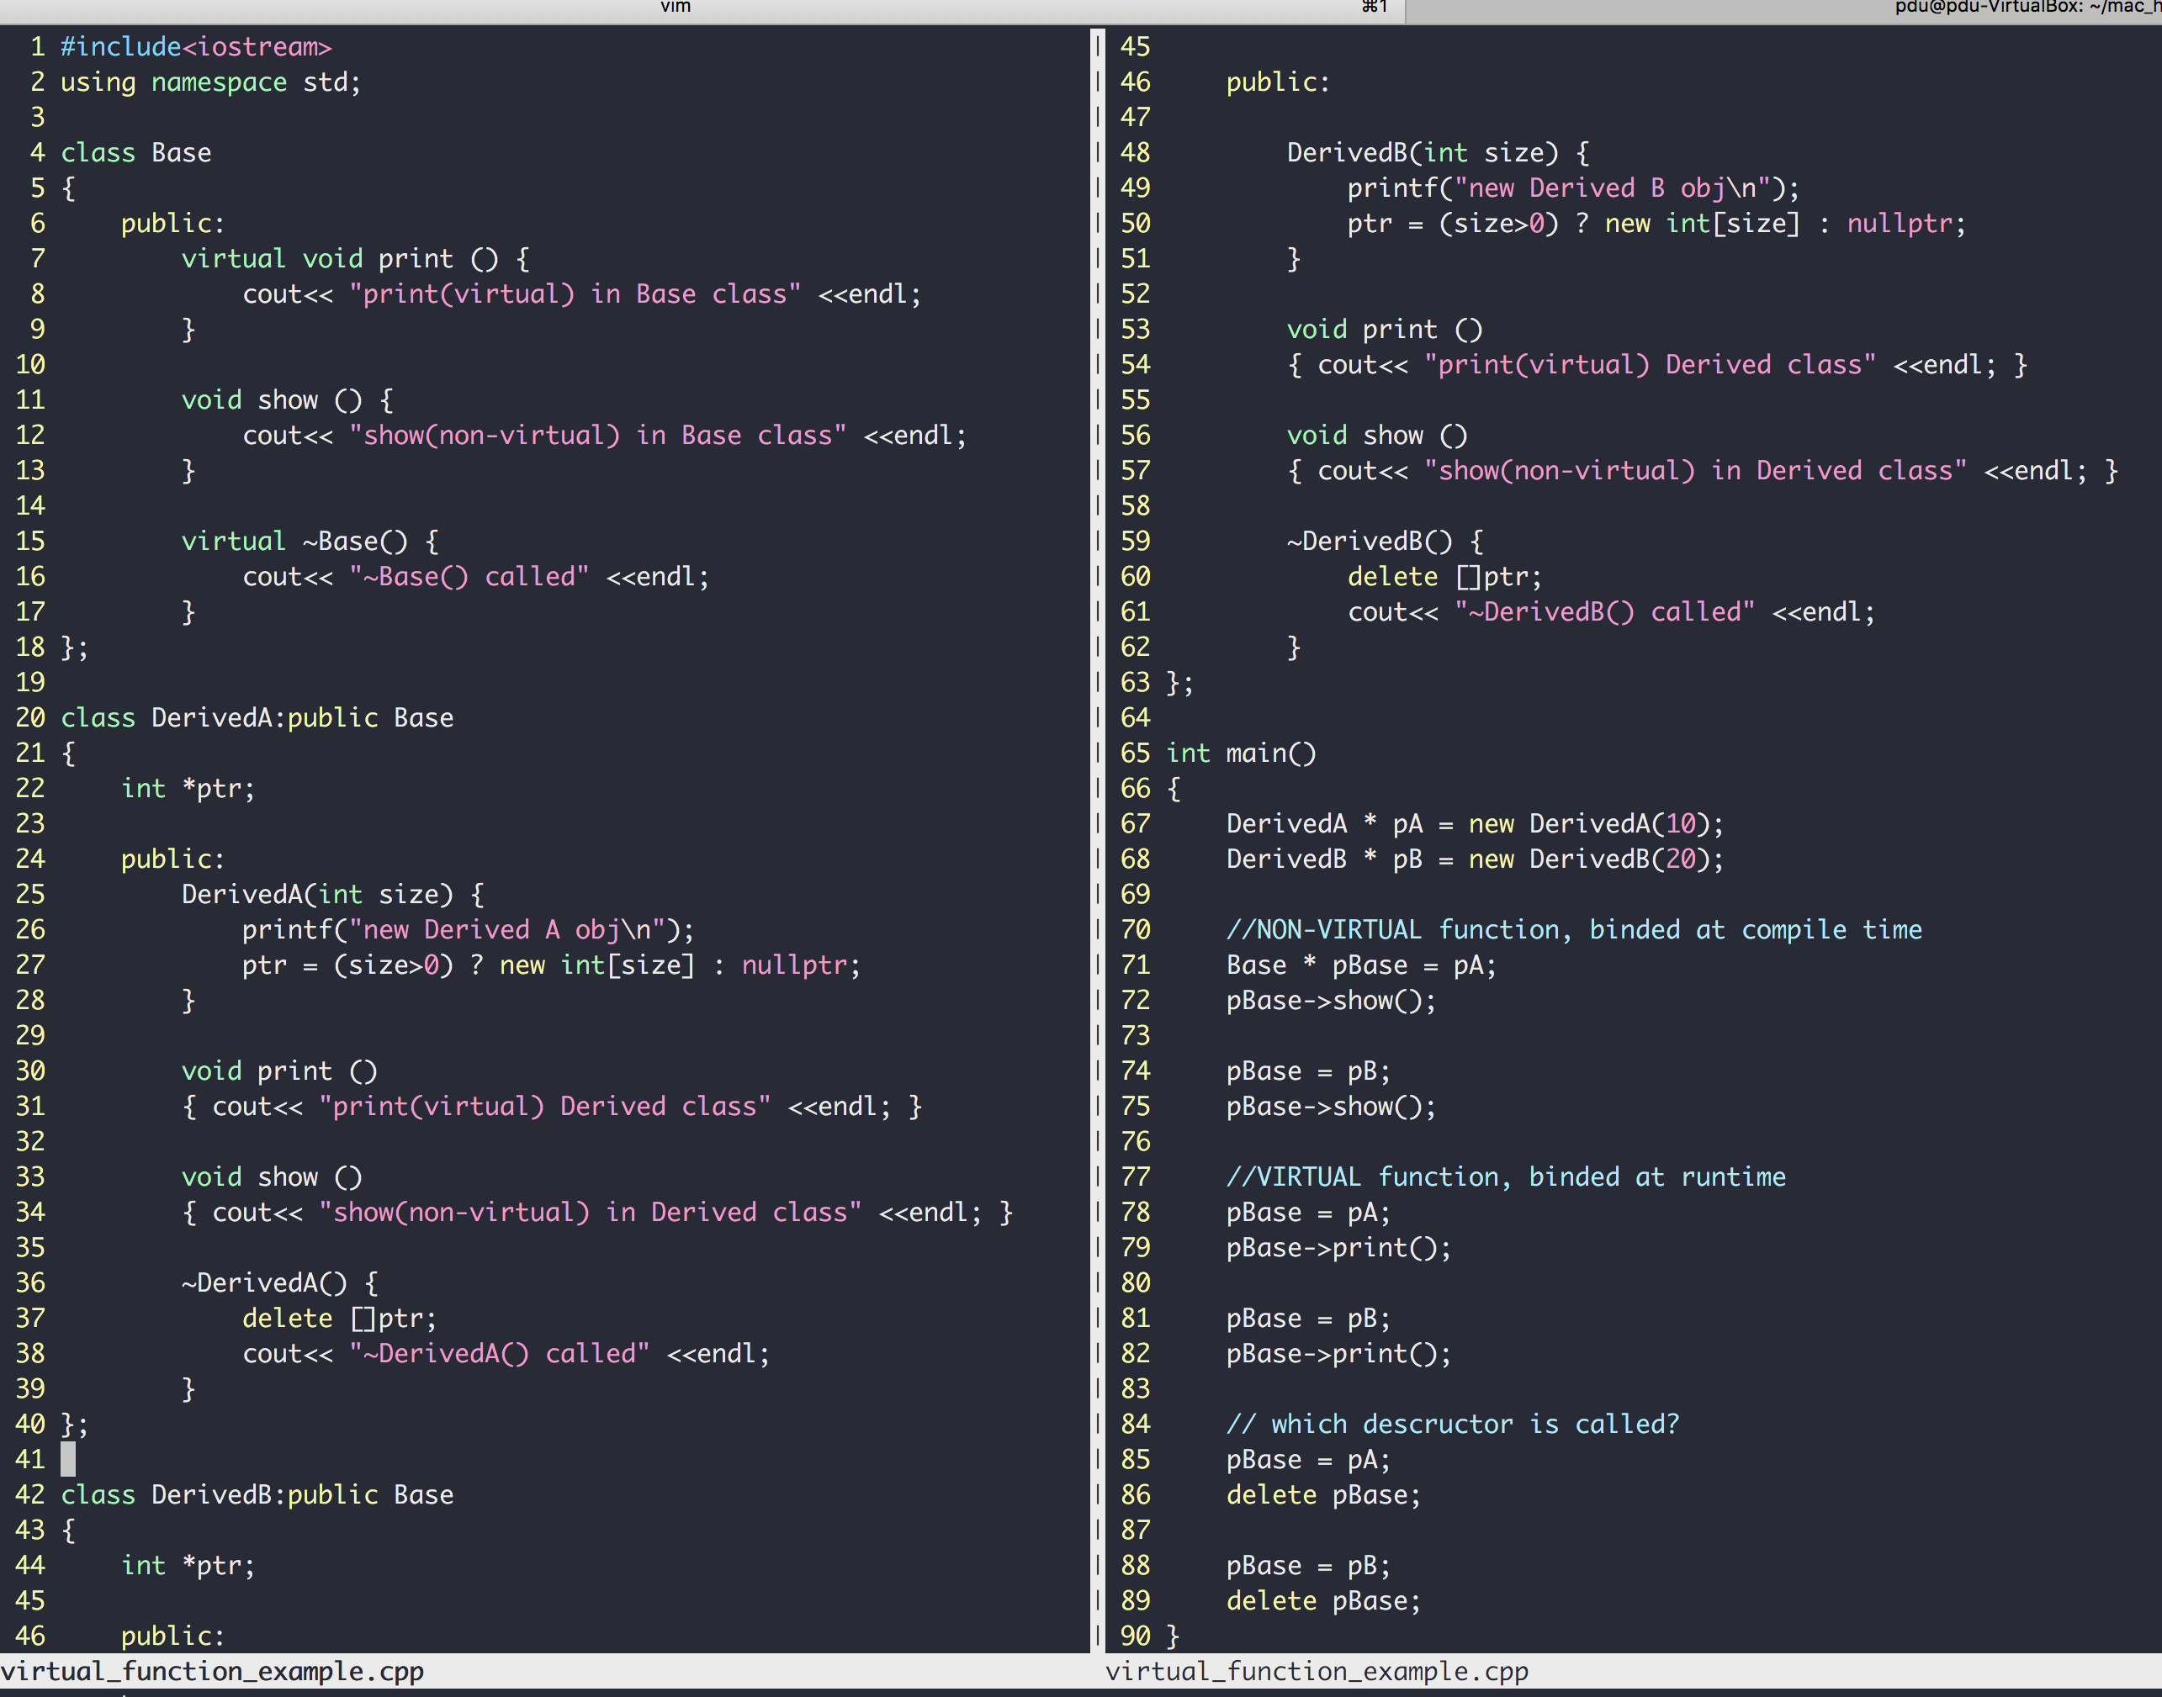
C++
“DerivedA class is a kind of Base class"
Class inheritance
Polymorphism
Virtual members
Pointers to base class
Invoke derived func
more example here
Same base pointer, different functions invoked (dynamic binding)

Slide 9
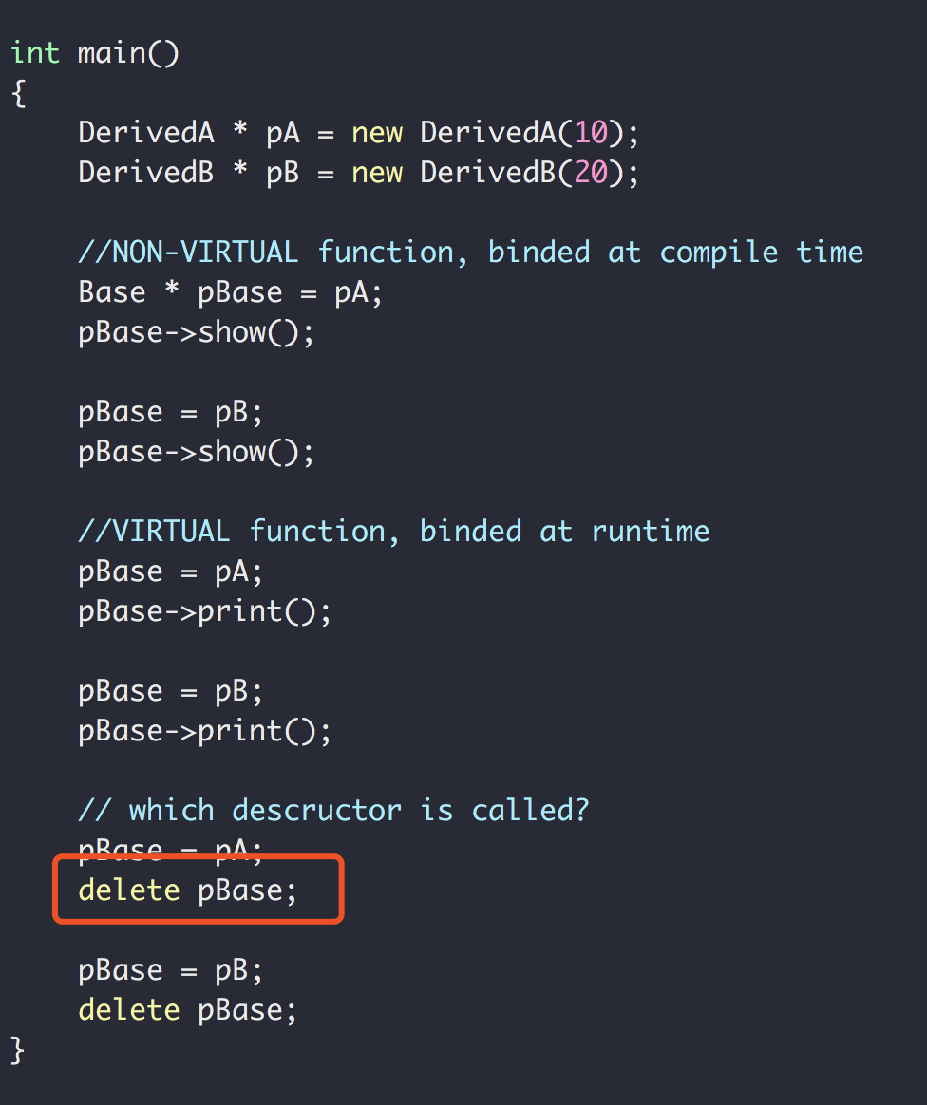
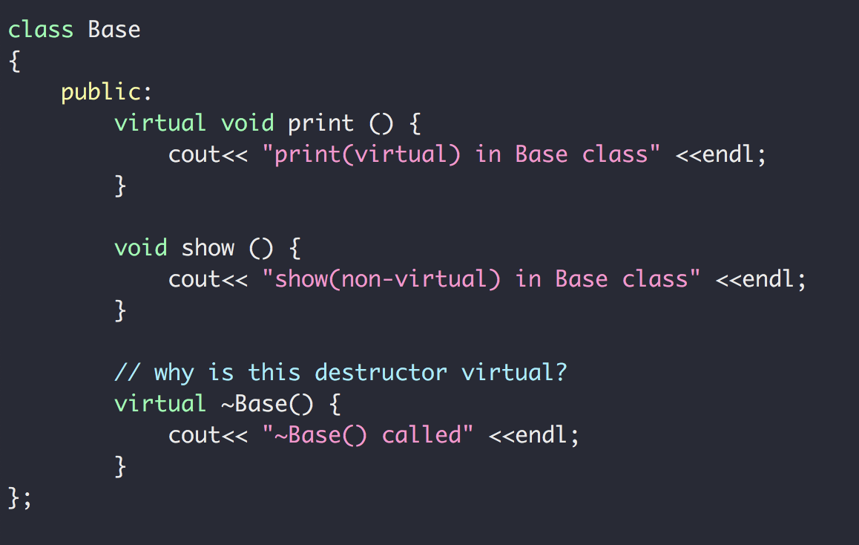
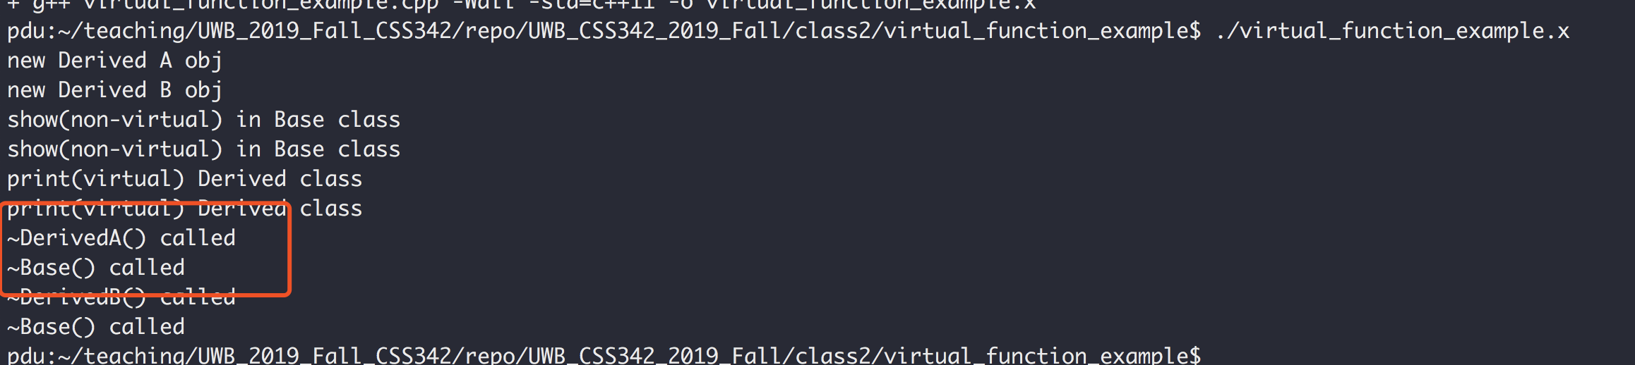
C++
So why the virtual destructor?
Also see https://www.youtube.com/watch?v=jELbKhGkEi0&t=56s

Slide 10
C++ Exercise
A card class
Has only one member function called area() that returns the area of the card
Write the class for card, square card and circular card
area() is implemented in the way of polymorphism
Square Card
Area = width x height
card
Circular Card
Area = pi x radius²
Area = ??

Slide 11
C++ Review
Template
A parameterized blueprint
Function Template (code: function_template)
Class Template (code: card_exercise/templated_version/)

Slide 12
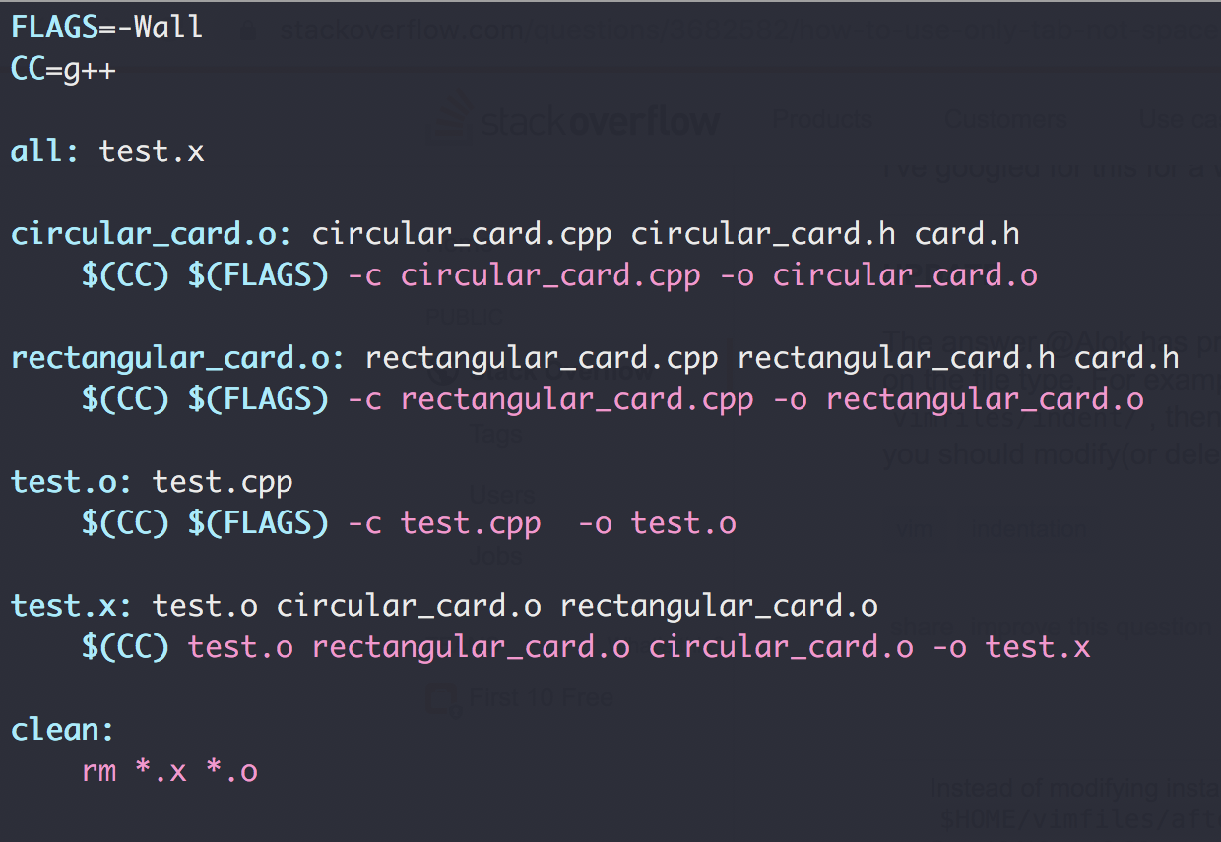
Makefile
goal
dependencies
actions

Slide 13
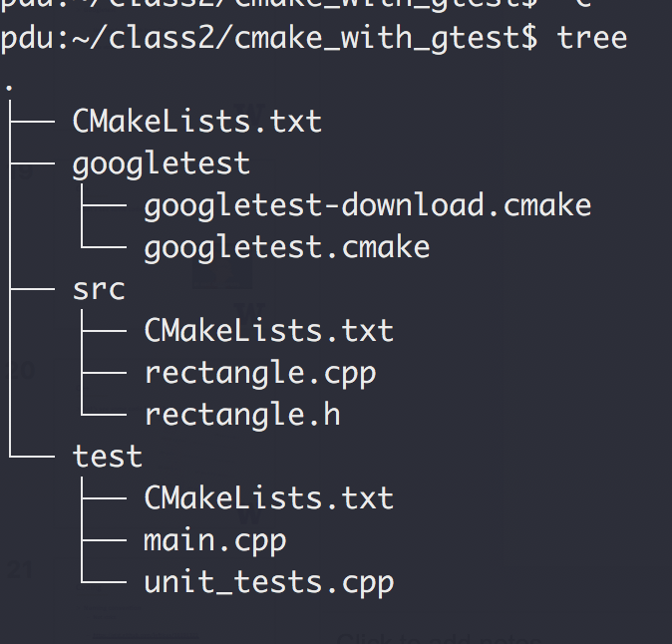
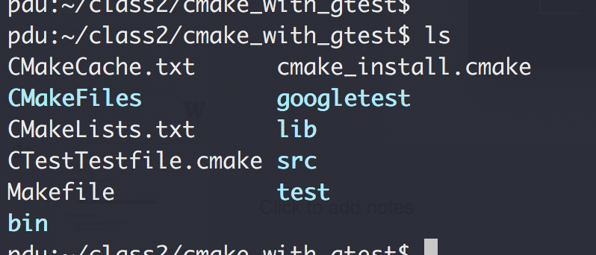
CMake
Tools that write Makefile for you!
Cross-platform (Yes, Windows too)
cmake .
make

Slide 14
Coding
Naming convention
Not strict
https://gist.github.com/lefticus/10191322
Bottomline:
Pick and follow a rule set
Be consistent

Slide 15
Coding
Avoid duplicates
No same logic more than once!
Comments
On intent, not action
Modular
Cohesion: 1 task per module
Coupling: As loosely coupled as possible
Variable Naming
Jacob’s guide

Slide 16
Coding
Testing
Unit tests
Integration tests
Test Driven Development
Video: “TDD, Where Did It All Go Wrong”

Slide 17
END OF C++ REVIEW

Slide 18
Object-Oriented Analysis And Design
What does “problem solving” mean?
Give a list of elements, implement the following function:
Add an element to the back of the list push_back(…)
Remove an element from the front of the list pop_front(…)
3
9
1
7
5
4
2
0
pushBack(…)
popFront(…)
4
2
0

Slide 19
Object-Oriented Analysis And Design
What does “problem solving” mean?
Give a list of elements, implement the following function:
Add an element to the back of the list push_back(…)
Remove an element from the front of the list pop_front(…)
10 mins, design and write the code
Use array in C++ to storage the data

Slide 20
Object-Oriented Analysis And Design
Let’s see some code

Slide 21
Object-Oriented Analysis And Design
What does “problem solving” mean?
Give a list of elements, implement the following function:
Add an element to the back of the list push_back(…)
Remove an element from the front of the list pop_front(…)
Procedural (aka steps)
Class Entity
array
Array
pushback()
popFront()
Member variables
PushBack()
Member functions
PopFront()
Test
Test()

Slide 22
Design Principals (“Specification” in C++ ch. 1.3)
Modular design
Split a problem into modules (e.g. classes)
Each modules states what it does
No module “know” how any other module works
Applies to
Single application (e.g. main, list, test)
Large scale Microservices (see how Uber does it)
And remember the class scheduling example?

Slide 23
Design Principals (“Specification” in C++ ch. 1.3)
https://medium.com/edureka/microservice-architecture-5e7f056b90f1

Slide 24
Design Principals (“Specification” in C++ ch. 1.3)
Operation Contracts
What methods are available to public
How a method can be used
Inputs
Outputs
Exception
What limitations
Example:
List in C++ Standard Template Library (STL)
Facebook’s /{object-id}/likes API

Slide 25
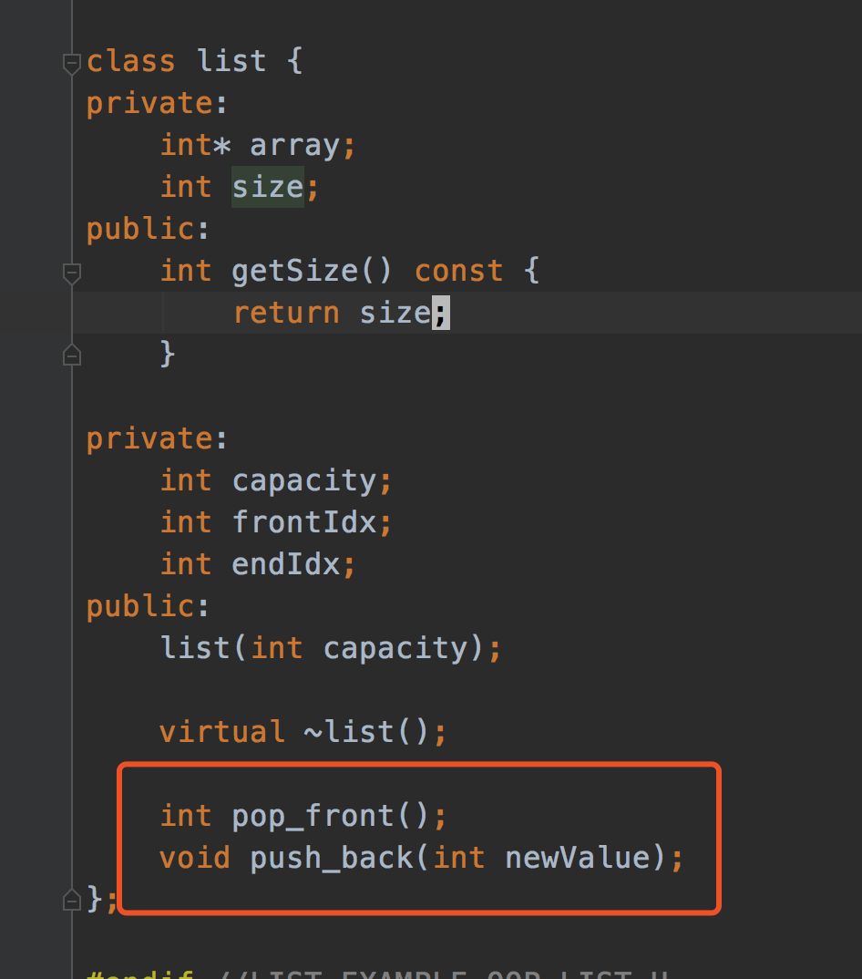
Design Principals (“Specification” in C++ ch. 1.3)
Unusual Conditions
Assume invalid situations never occur
Ignore the invalid situations
Guess (Assume) client’s intention
Return a value signaling a problem
Throw an exception
Error Hiding (swallowing)

Slide 26
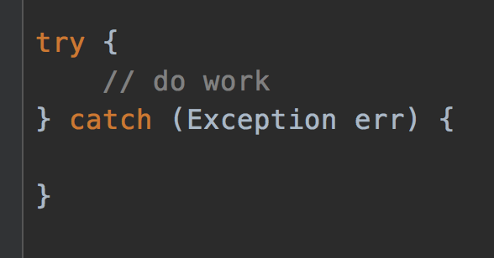
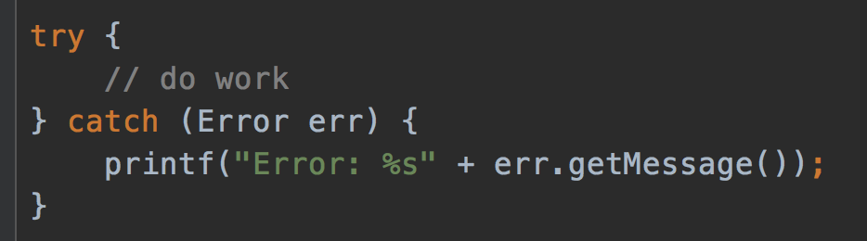
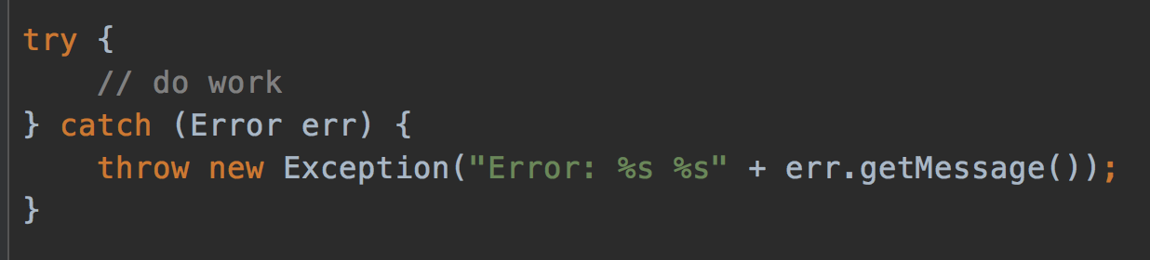
Error hiding
VERY BAD
STILL BAD
GOOD, but how to improve?
https://www.ibm.com/support/pages/best-practice-catching-and-re-throwing-java-exceptions

Slide 27
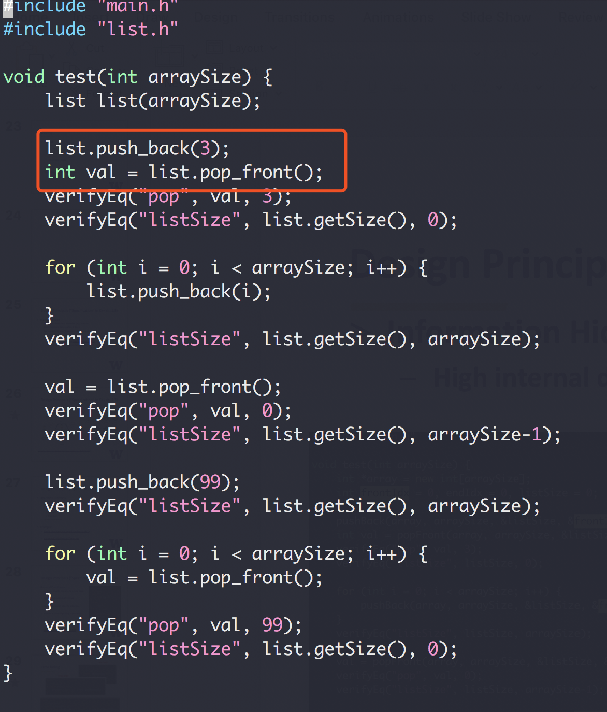
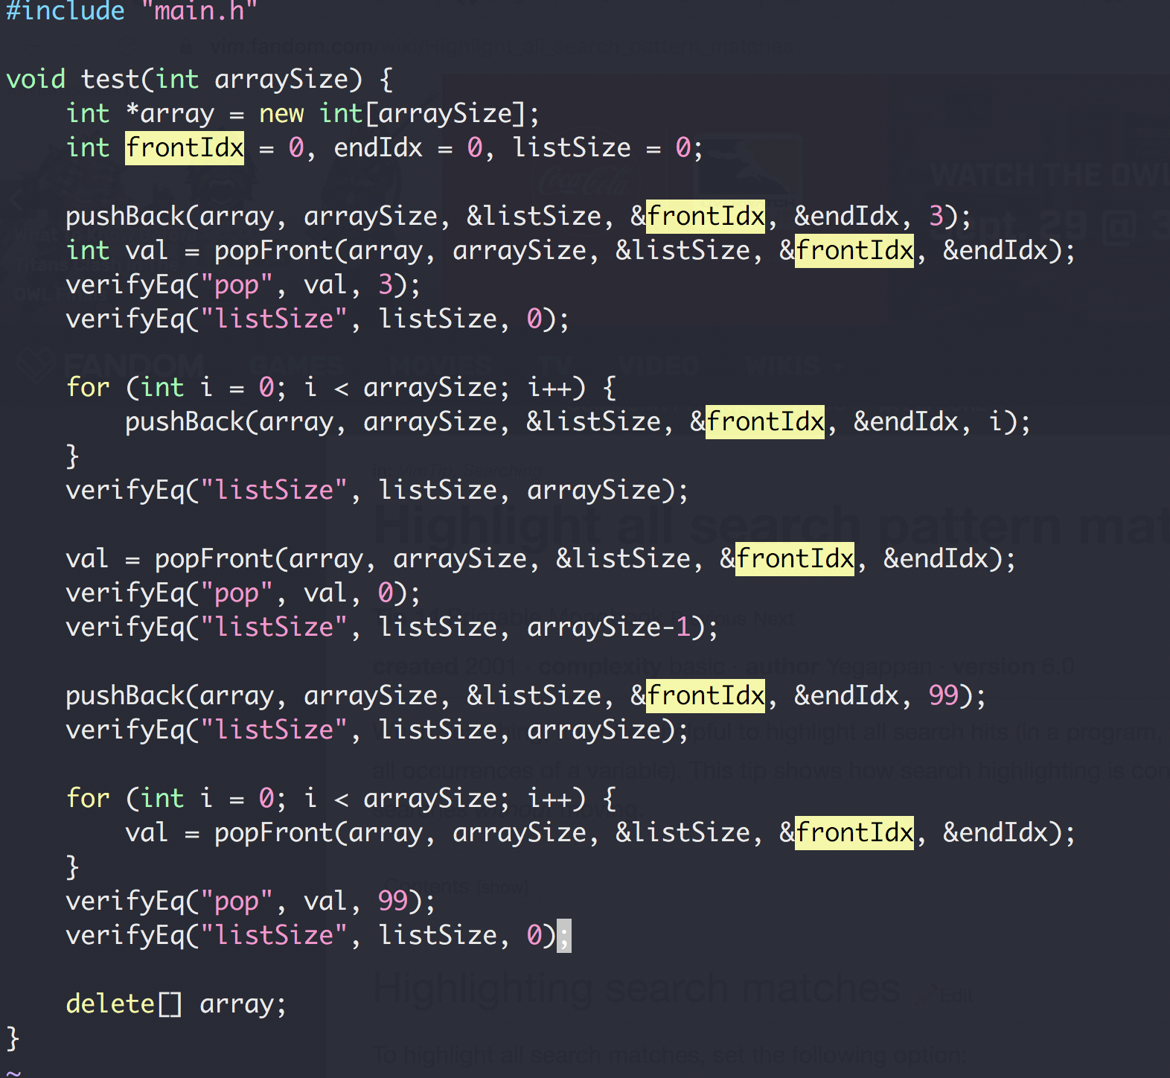
Design Principals (“Specification” in C++ ch. 1.3)
Information Hiding
High internal details from external clients

Slide 28
OOP Design
A bag of card of different shape cards
Exercise

